Slide 1
🌱 FarmOG Station
AI-Powered Disease Detection for Off-Grid Farms
Diogo Simoes | Data Science & ML Bootcamp

Slide 2
The Problem
🌾 Crop diseases cause 20-40% yield loss globally
📱 Small farmers have limited access to agricultural experts
⏰ Late detection = diseases spread before treatment
💰 Economic impact of crop failure is devastating
Solution: AI-powered system that works anywhere, anytime

Slide 3
FarmOG Station - The Solution
📷 Computer Vision: 98.74% accuracy disease identification
📊 Environmental Sensors: Monitor soil, weather conditions
🤖 Intelligent Fusion: Cross-validates both inputs
🔋 Off-Grid Ready: Runs on Raspberry Pi, no internet needed
Three Detection Modes:
• Vision Only - Quick photo diagnosis
• Sensor Only - Environmental risk assessment
• Full Fusion - Cross-validated high-confidence diagnosis

Slide 4
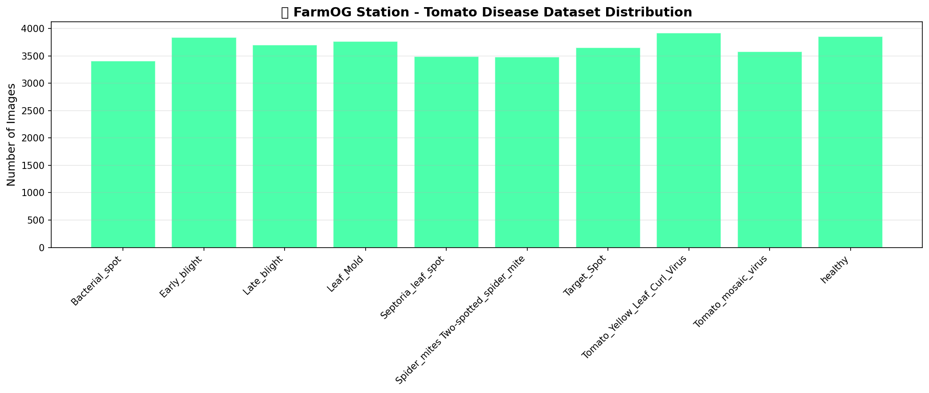
Dataset: 87,000 Images, 10 Disease Classes
Balanced distribution across 9 tomato diseases + healthy baseline

Slide 5
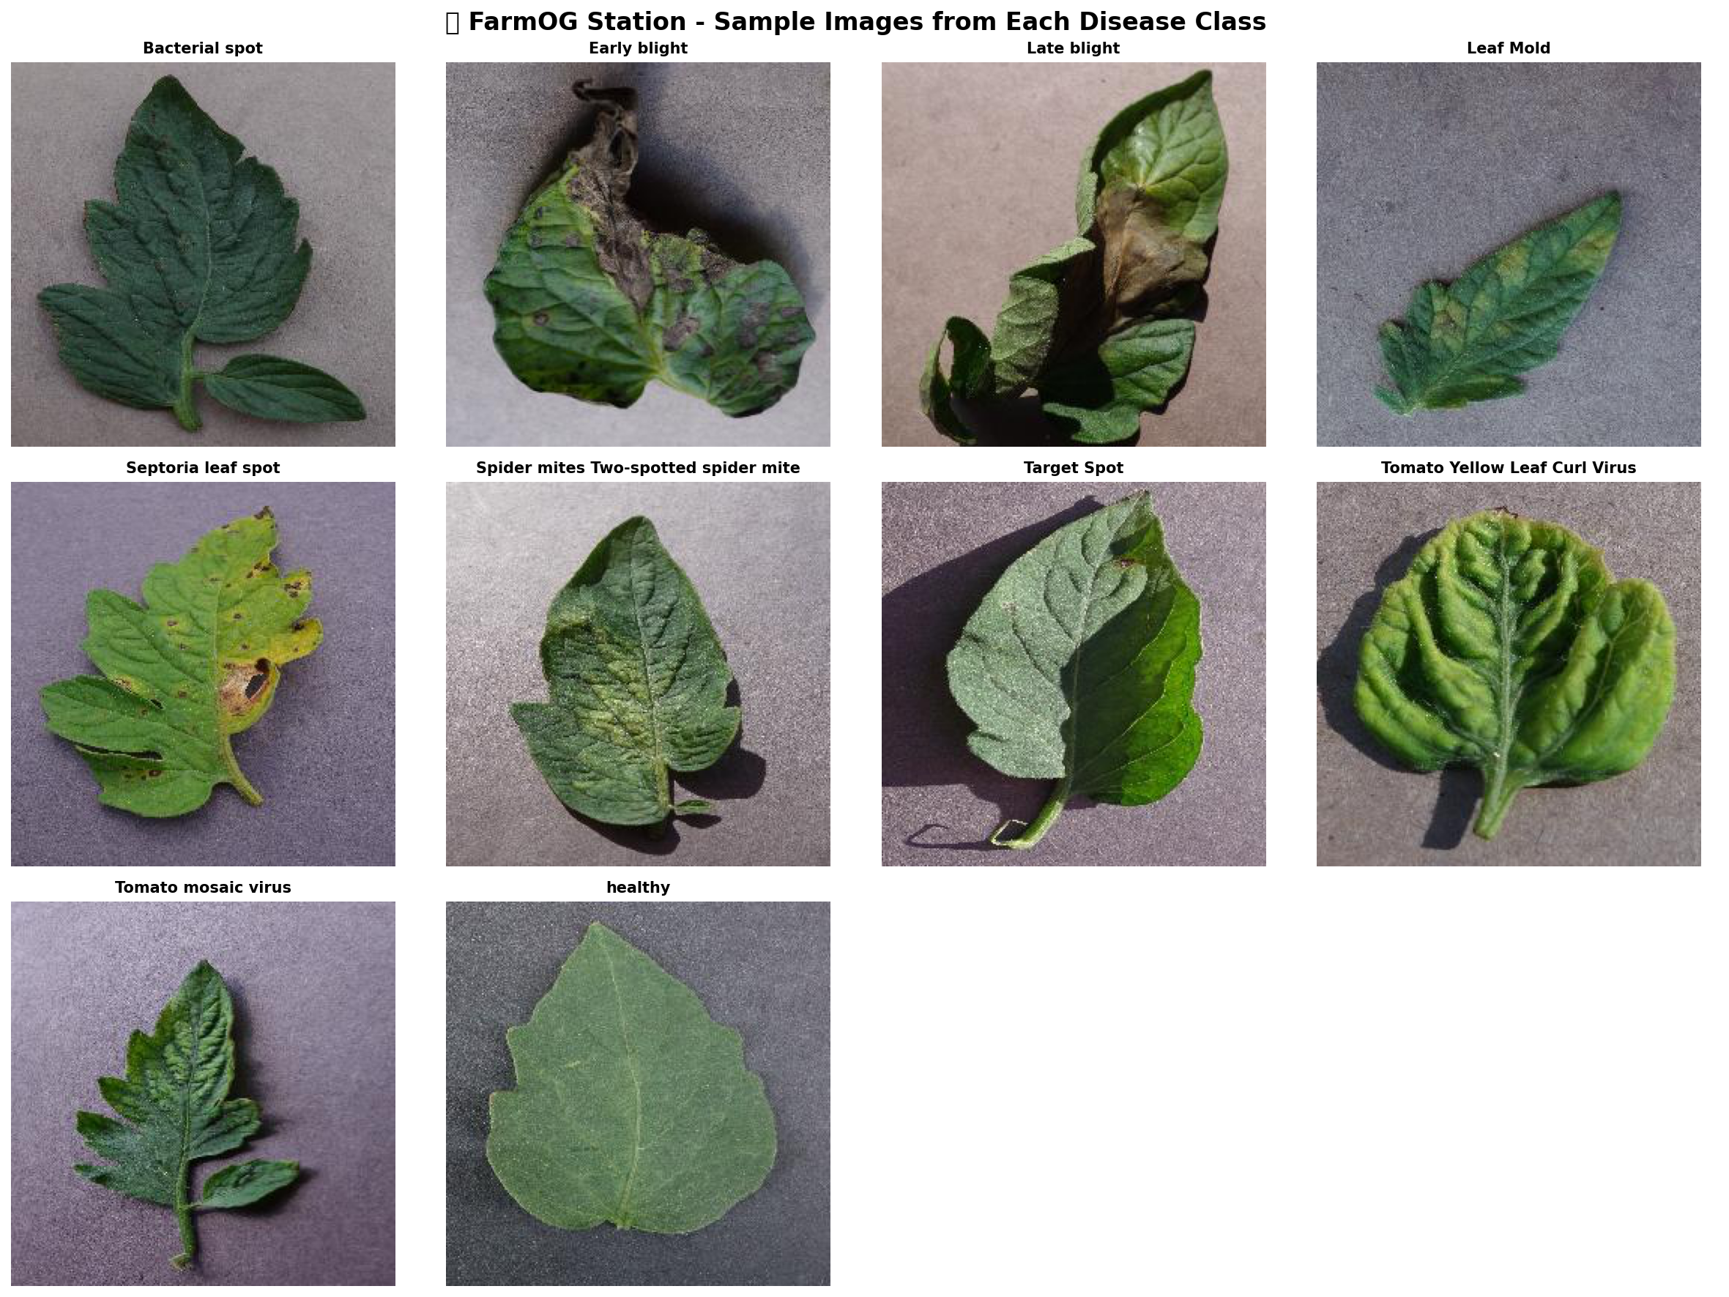
Disease Examples
Visual diversity in disease symptoms

Slide 6
Three Model Architectures Trained
ResNet50V2: 98.74% accuracy (25M params)
→ Best: Production deployment
→ Top-3 Accuracy: 99.96% (near-perfect)
EfficientNetB0: 93.37% accuracy (5.3M params)
→ Best: Balanced performance
MobileNetV2: 90.05% accuracy (3.5M params)
→ Best: Raspberry Pi edge deployment
→ Inference: <100ms
Critical Discovery: Each model needs specific preprocessing!

Slide 7
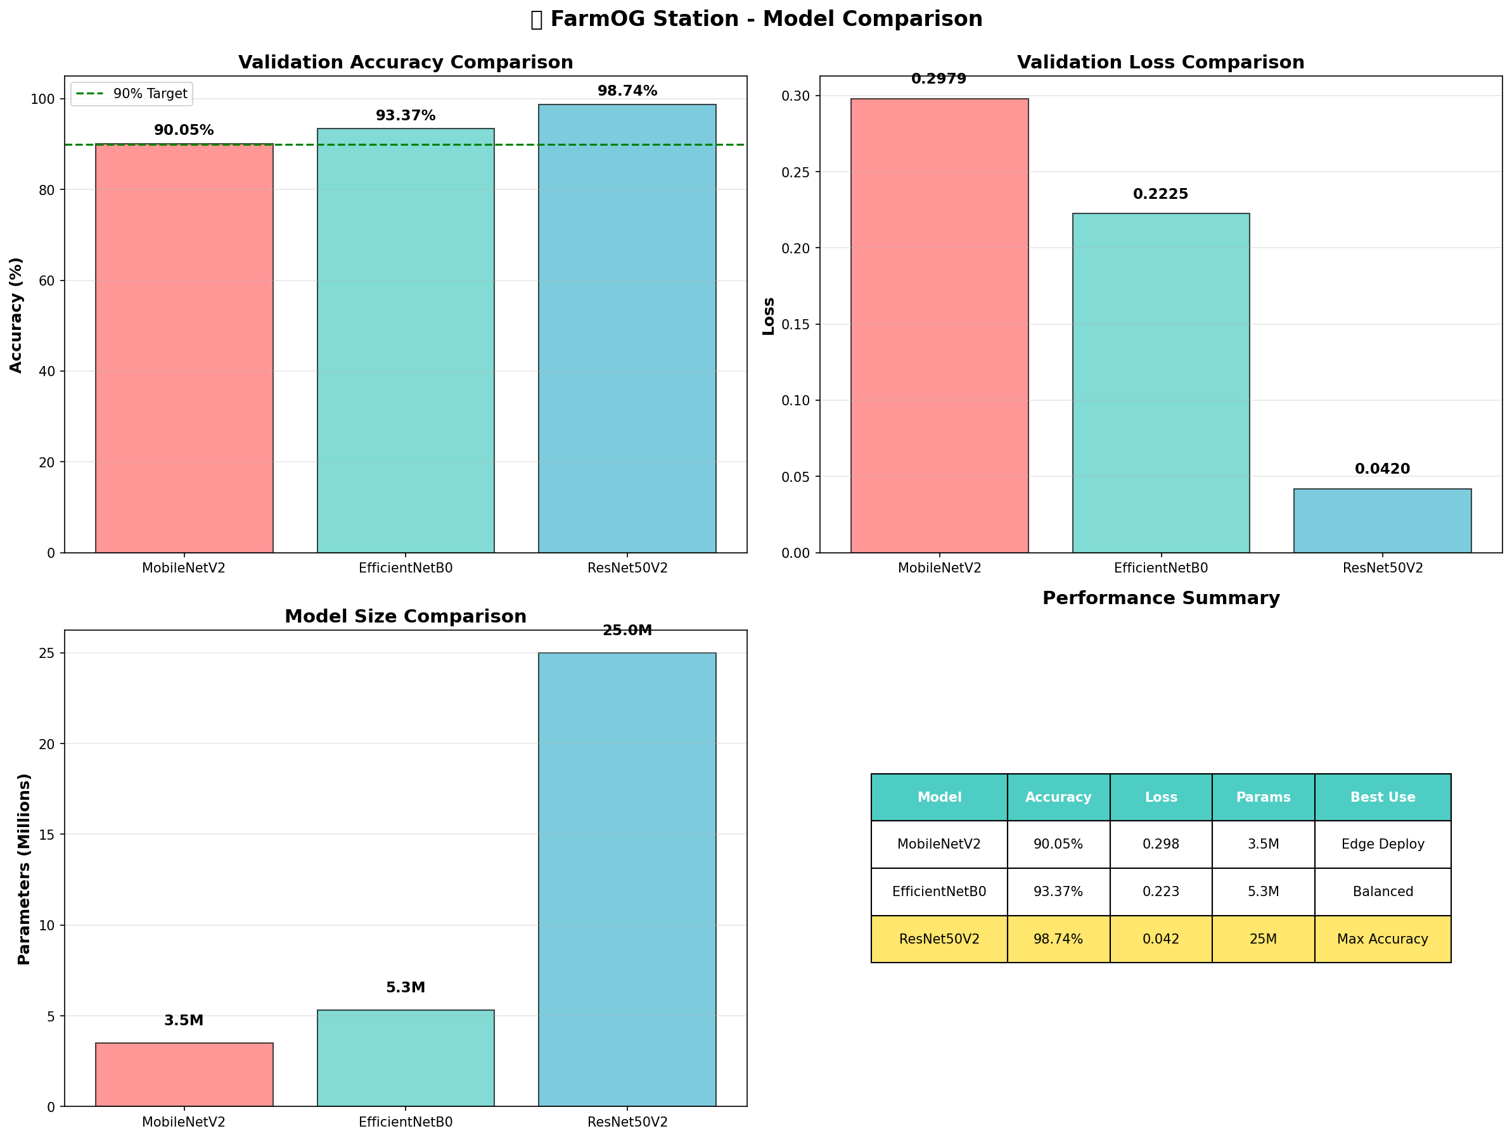
Model Performance Comparison
ResNet50V2 achieves best accuracy (+8.69% over MobileNetV2)

Slide 8
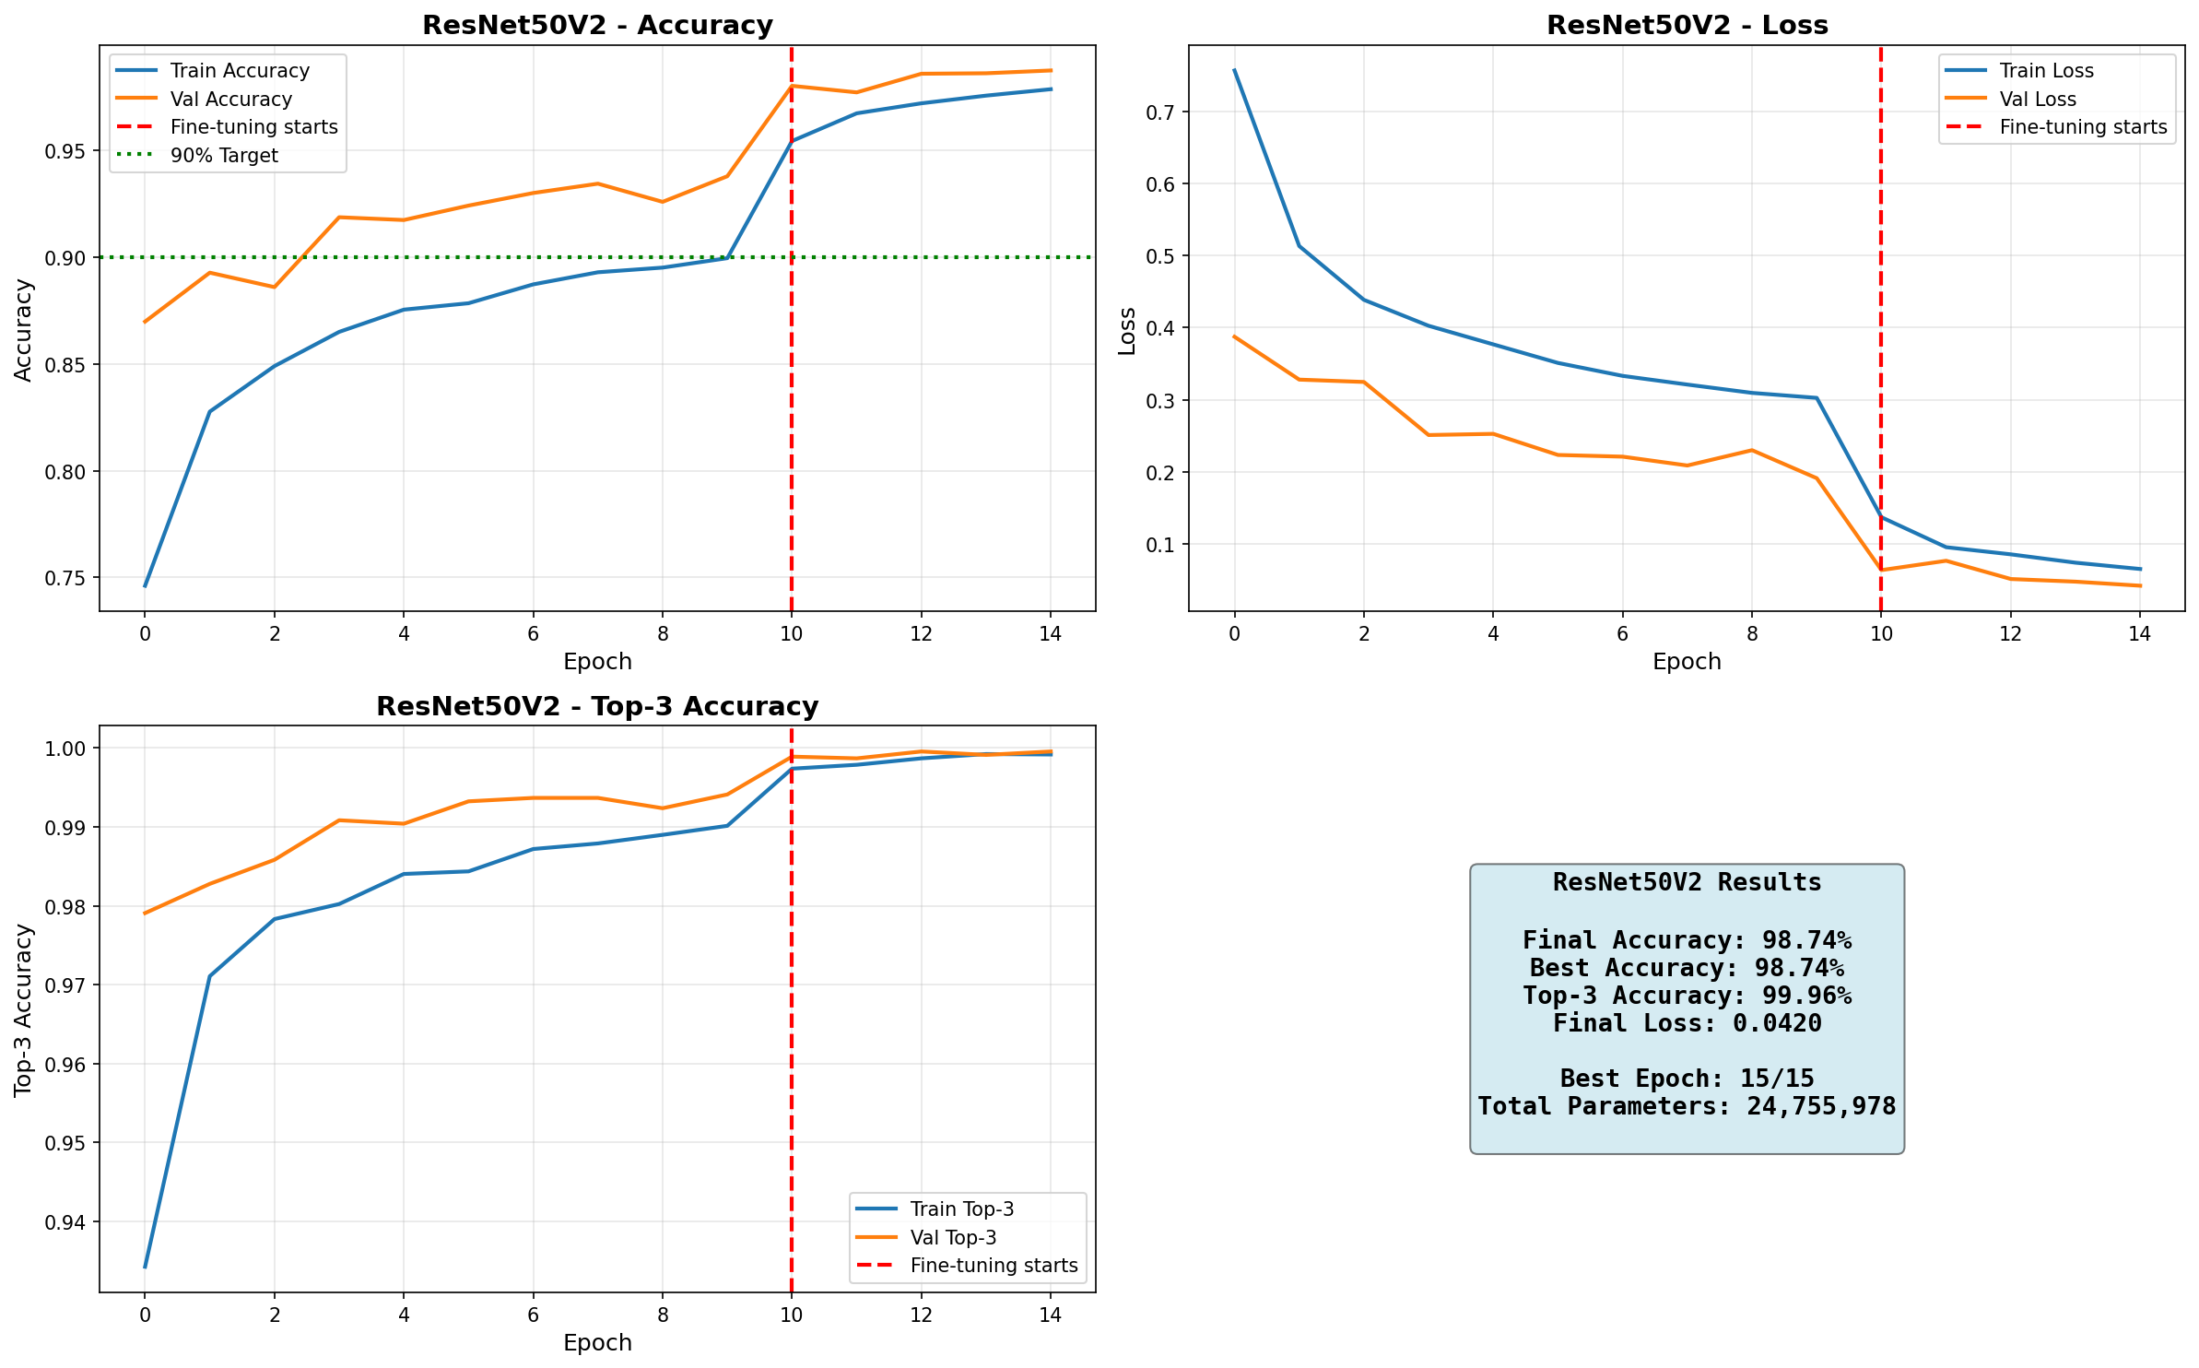
ResNet50V2 Training Progress
Smooth convergence with two-phase training (frozen → fine-tuning)

Slide 9
Critical Technical Discovery
Initial Problem: Models got 10-25% accuracy ❌
Root Cause: Wrong preprocessing!
• Used: rescale=1./255 (generic normalization)
• Should use: Model-specific preprocessing functions
The Fix:
• EfficientNet: efficientnet.preprocess_input
• ResNet: resnet_v2.preprocess_input
Result: Accuracy jumped to 93-98% ✅
Lesson: Each architecture expects specific input normalization

Slide 10
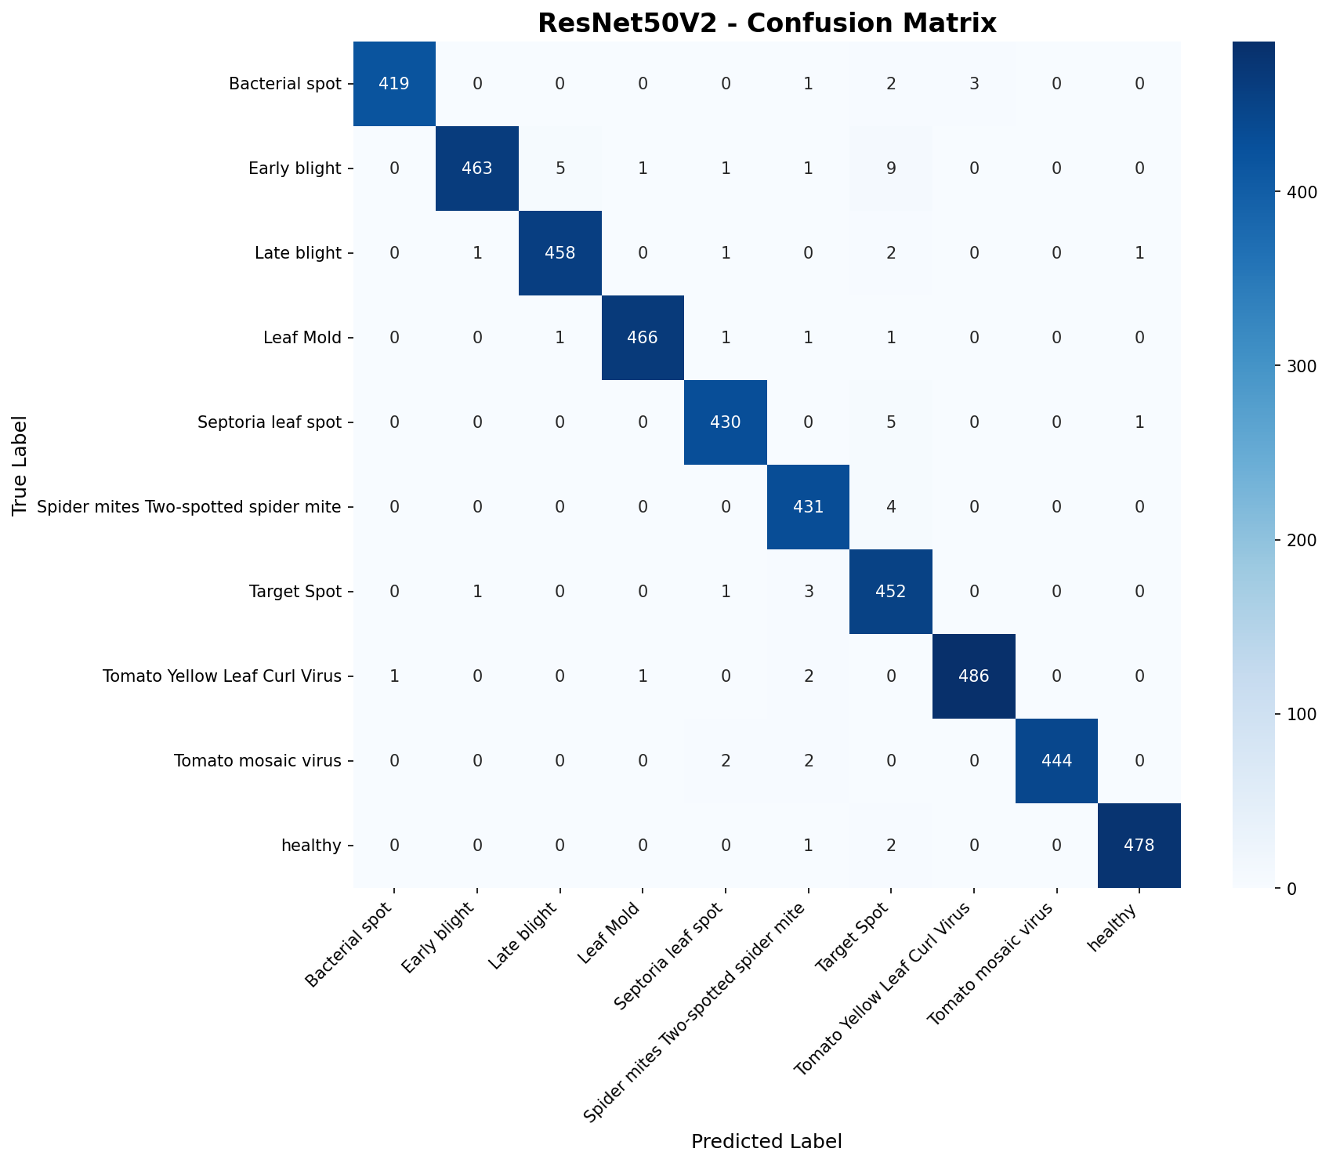
Confusion Matrix: ResNet50V2
Excellent class separation - 98.74% accuracy, <2% misclassification

Slide 11
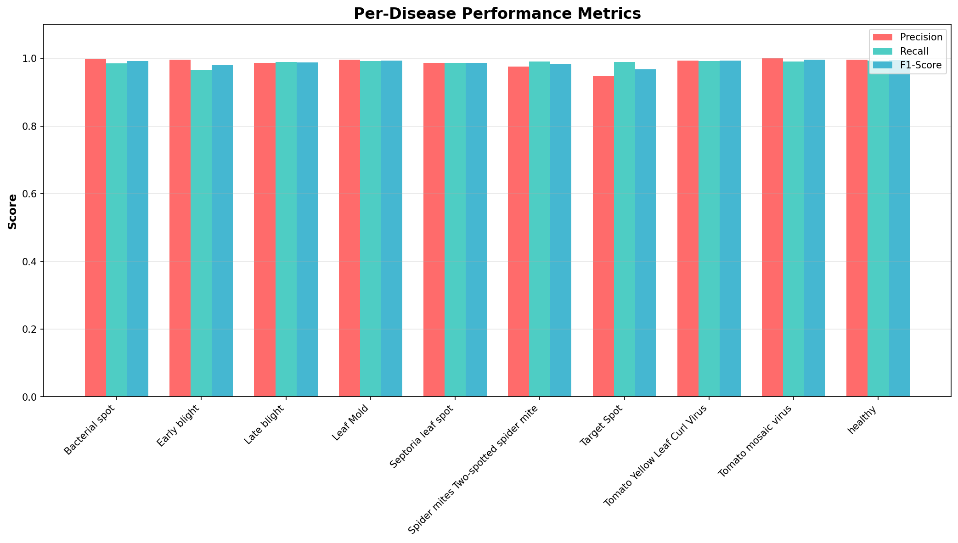
Per-Disease Performance Metrics
Balanced performance: F1-scores 0.96-1.00 across all diseases

Slide 12
Multi-Modal Fusion System
Vision Path:
→ ResNet50V2 CNN → Disease predictions (0-100% confidence)
Sensor Path:
→ Environmental data → Disease risk scores (0-100%)
→ Rule-based signatures from agricultural research
Fusion Engine:
→ Cross-validates vision + sensor predictions
→ CONFIRMED: Both agree (high confidence)
→ EARLY_WARNING: Sensor alerts before symptoms
→ CONFLICT: Disagreement → flag for review
→ LOW_CONFIDENCE: Uncertain → recommend monitoring

Slide 13
Outstanding Results
📊 Model Performance:
• Validation Accuracy: 98.74%
• Top-3 Accuracy: 99.96% (near-perfect ranking)
• F1-Scores: 0.96-1.00 across all classes
🎯 Business Value:
• Early detection saves 20-40% crop loss
• $50 Raspberry Pi vs $500 agronomist consultation
• Unlimited diagnoses vs limited expert availability
🚀 Deployment Ready:
• TensorFlow Lite conversion complete
• Streamlit web app functional
• All 3 detection modes operational

Slide 14
Live Demo - Three Detection Modes
Vision Only Mode:
→ Upload leaf image → Instant diagnosis
→ Shows top 3 predictions with confidence
→ Recommended actions & root cause
Sensor Only Mode:
→ Input environmental data
→ Risk assessment before symptoms appear
→ Preventive actions to stop disease spread
Fusion Mode (The Power!):
→ Combines vision + sensors
→ Cross-validated diagnosis
→ Reduces false positives <5%

Slide 15
Next Steps & Future Work
Phase 1: Hardware Integration (Next 3 months)
• Deploy on Raspberry Pi 4
• Integrate camera + environmental sensors
• Solar power + battery system
Phase 2: Field Testing (Months 4-6)
• Beta test with 5-10 local farms
• Collect real-world farmer-submitted images
• Refine model with field data
Phase 3: Scale & Expand (Months 6-12)
• Add more crops (peppers, cucumbers)
• LoRa communication for remote monitoring
• Mobile app companion
• Open-source hardware designs

Slide 16
Thank You!
Diogo Simoes
Data Scientist | Agricultural Technology Enthusiast
GitHub: github.com/diogosimoez
LinkedIn: linkedin.com/in/diogosimoes86
Questions?

